Slide 1
FIELD EFFECT TRANSISTOR
E.Kalyana Pallavi
Assistant Professor
AITK kadapa

Slide 7
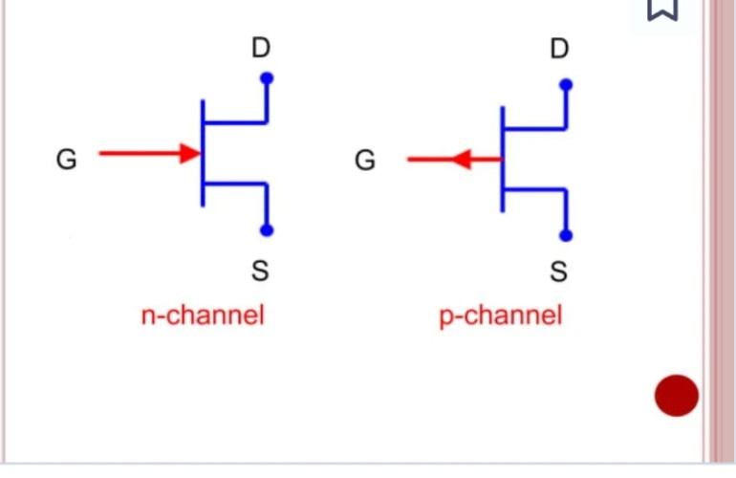

Slide 12
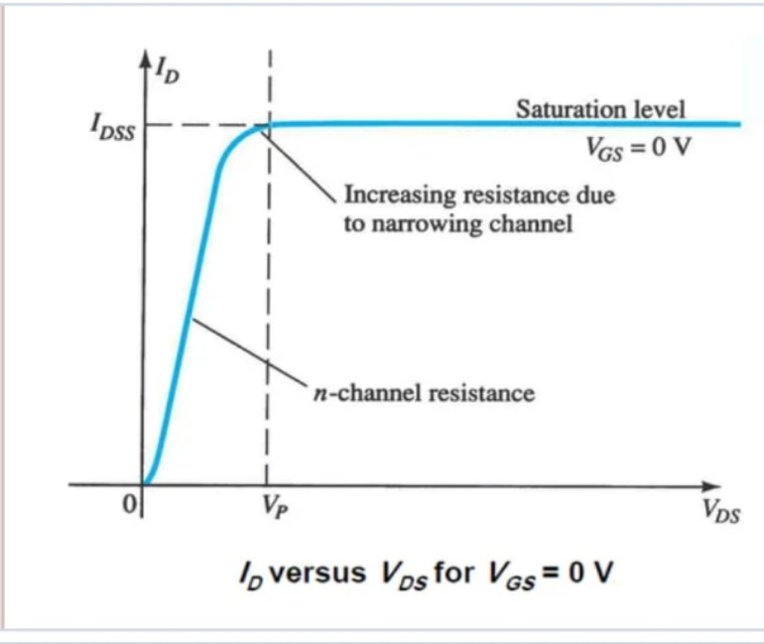

Slide 15
